Slide 1
Phoodie: Restaurant Point of Sale System

Slide 2
The Team
Anthony Quigley (ajquigle@oakland.edu) - Computer Science
Jiann-Cherng (Mel) Chi (jchi@oakland.edu) - Computer Science
Mitchell Moore (mamoore4@oakland.edu) - Computer Science
Timothy Parzynski (tpparzyn@oakland.edu) - Information Technology

Slide 3
Roles
Mostly Collaborative week
Mel - Requirements and Developmental Engineer, Project Manager
Anthony - Requirements and Developmental Engineer
Tim - Requirements and Quality Assurance
Mitch - Requirements Developmental Engineer
Continued research and group backend development
Iteration 2 begins our dedicated individual roles.

Slide 4
Requirements
Previous:
Got AWS, but nothing was truly connected
Had Mel’s Server up
RDS (MySQL server) was set up but had no interactions with other services

Slide 5
Requirements
Currently:
Login
Register
Validate email
Reset Password

Slide 6
Developmental
Previous:
Start the MySQL Utility Class
Demo site of how the app will work

Slide 7
Developmental
Currently:
Create Generic Utility Class
MySQL Class has all basic functionality, will need to add specific functions as time goes on to prevent injections
Ajax calls to communicate with server
Basic Framework 7 index page. Tablet and mobile view
Email Validation/Resetting Password

Slide 8
Developmental (cont.)
Added EC2 Instance (server) to correct CloudFormation template
Configured EC2 server to properly communicate with MySQL RDS server
Driver issues
Configured EC2 server using Tomcat to host java servlets
Servlet for logging in
Servlet for registering
Servlet for validating emails
Configured SES so we can send verification emails

Slide 9
QA
Previous QA: NONE
Current QA:
Began construction of various user stories
Created JUNIT Test Class for the MySQLUtilities (in progress)
Next Week:
Registration and login testing
Continue user stories and use cases
Consumer end UI prototype testing/poll

Slide 10
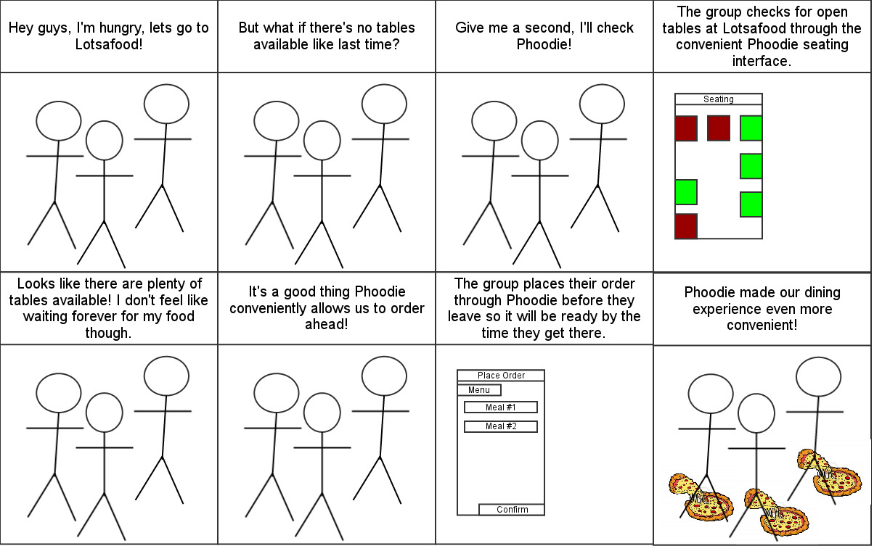
User Story
A group of friends looking to go out to eat.

Slide 11
Project Management
Switched from Google Calendar to Microsoft Project
Added more details of what needed to be done.
Met On Thursday to Plan Out what needed to be done.

Slide 12
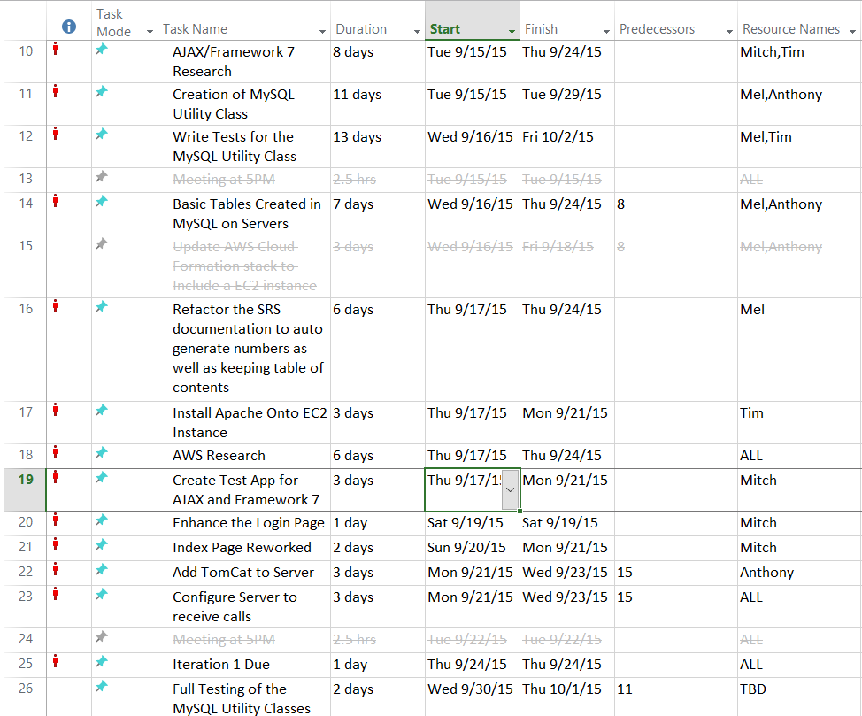
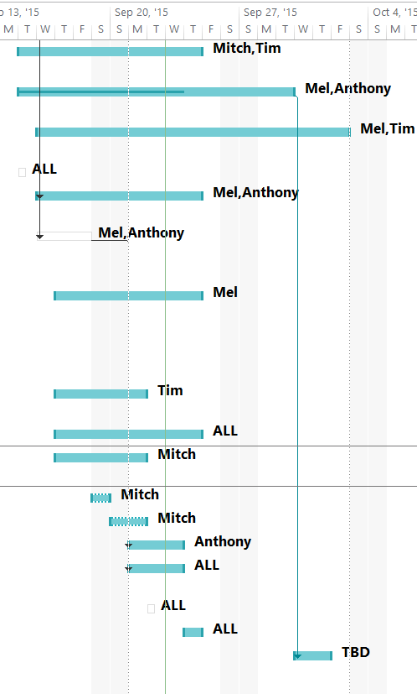

Slide 13
Schedule (previous)
Date | Iteration | Goals
9/24/2015 | 1 | Basic Server Setup, Main Tables completed
10/1/2015 | 2 | Host(ess)/Waiter(ress) System Food Ordering System done Basic MySQL Utilities
10/8/2015 | 3 | Final Requirements and Bug Fix Week
10/15/2015 | 4 | Kitchen Interface Finished

Slide 14
Schedule (projected)
Date | Iteration | Goals
9/24/2015 | 1 | Basic Server Setup Basic MySQL Utilities
10/1/2015 | 2 | Main Tables completed Host(ess)/Waiter(ress) Food Ordering Enhance MySQL Utilities
10/8/2015 | 3 | Kitchen Interface Finished

Slide 15
This week
Main Tables must be completed
Host(ess)/Waiter(ress) Front End
Food Ordering System
Continued Upkeep of SRS

